Slide 1
Team 83 Presentation
Team members: Sagar Dalwadi & Murtaza Lodgher

Slide 2



Introduction
Heart failure (HF) is a difficult disease to detect early on, as many as many of the early signs and symptoms are common across different kinds of common diseases
The “onset of HF is associated with a high level of disability, health care costs, and mortality” (Choi et al., 2017, pg. 362)
Our chosen paper explores how RNN models can be used to detect HF as early as possible, more so than conventional DL methods

Slide 3
Scope of Reproducibility and Ablations
Our main claim we want to reproduce is that RNN models using gated recurrent units (GRUs) were able to yield a higher area-under-the-curve (AUC) for predicting HF diagnoses through electronic health record (EHR) data over conventional deep learning methods, like logistic regression, SVM and KNN.
Our ablation to the original code we implemented is changing the activation function of the GRU to see if the accuracy differs

Slide 4
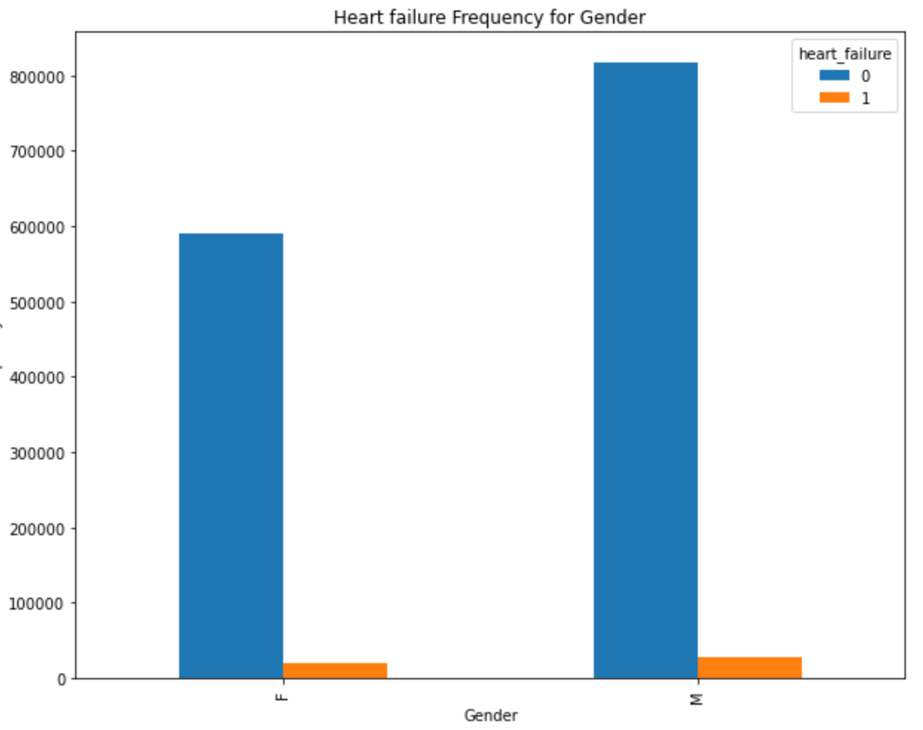
Data description
We used datasets from the MIMIC data located in Physio.Net.
Data includes hospital admissions data, ICU length data, ICD code data for patient diagnosis and procedures, lab event records, and prescriptions data.

Slide 5
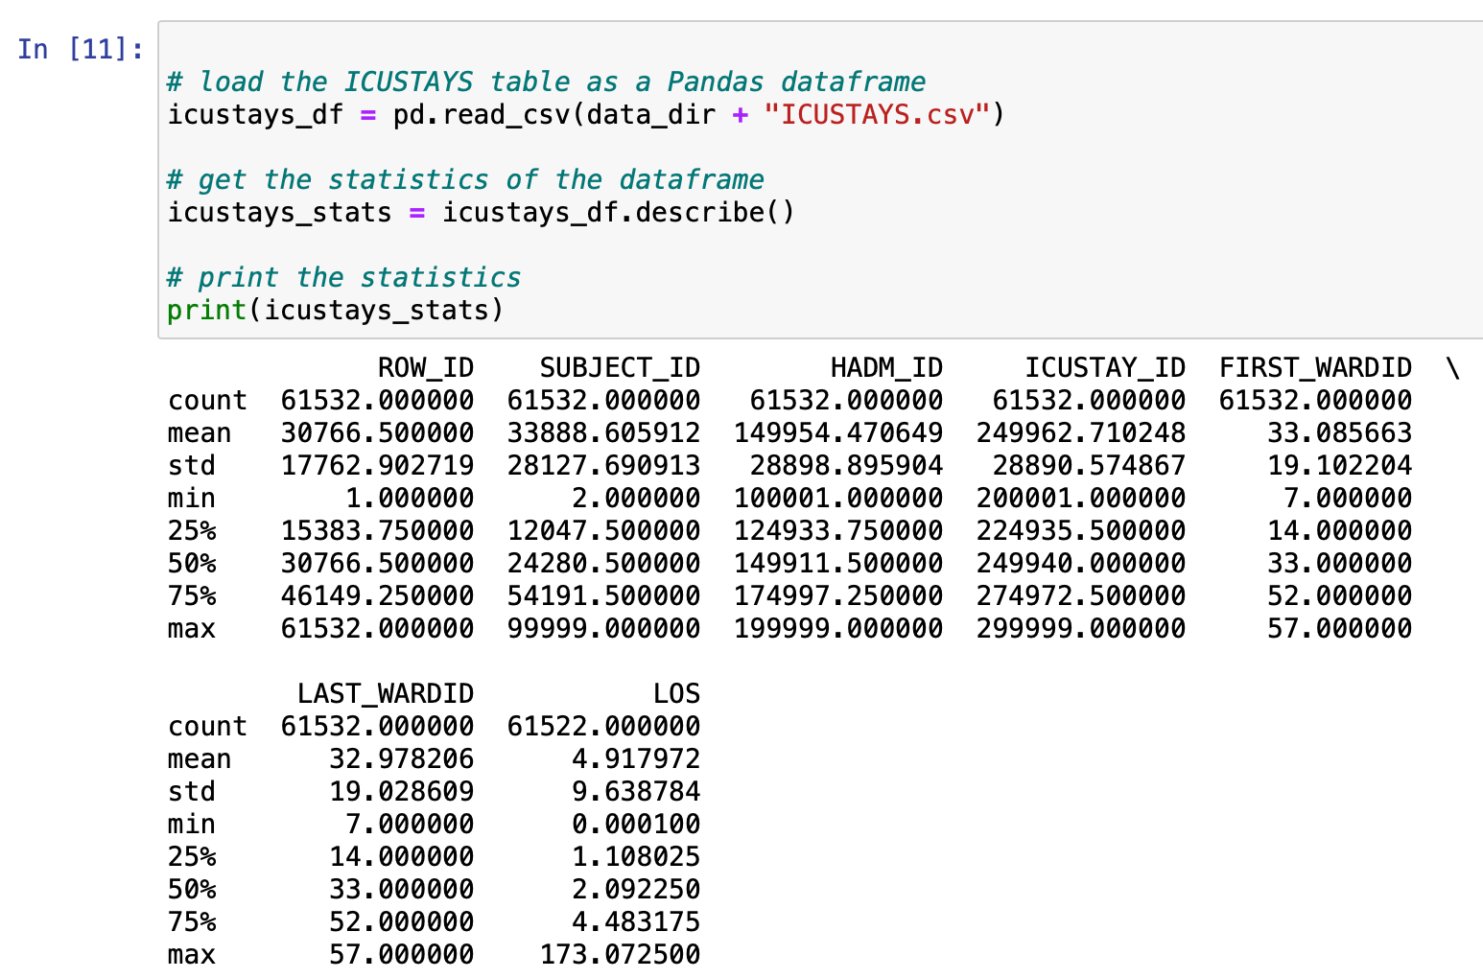
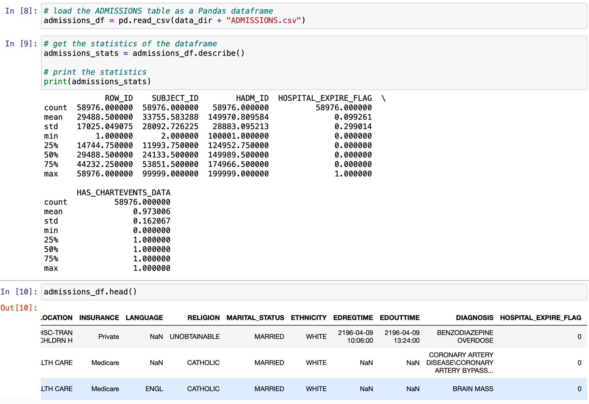
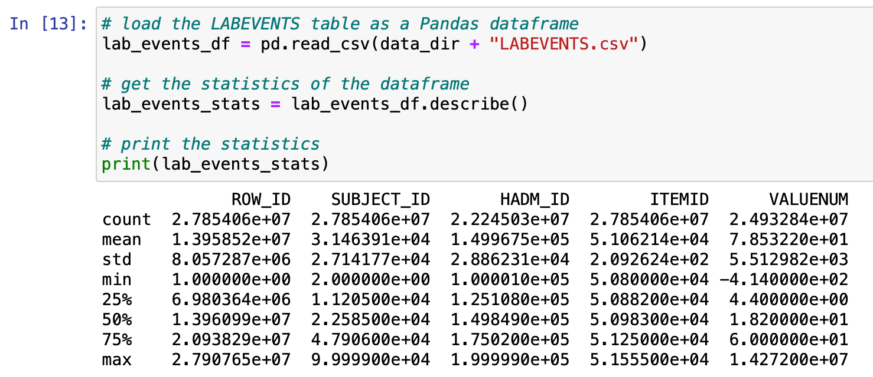
Data Statistics

Slide 6
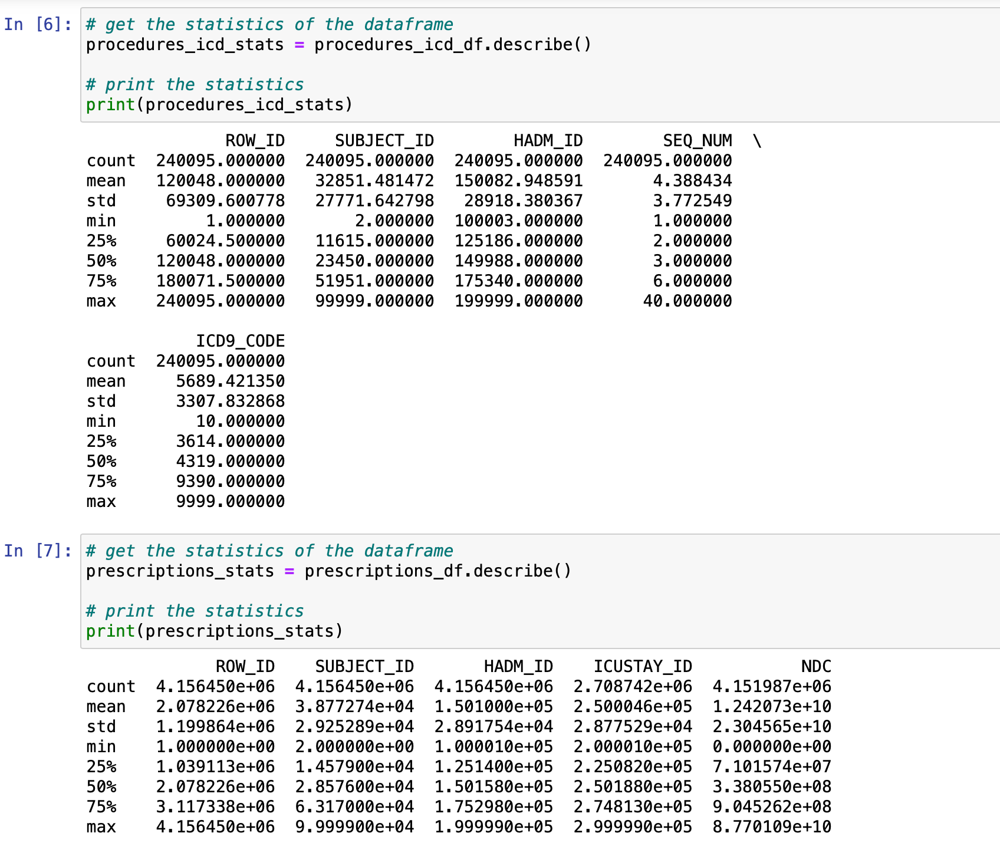
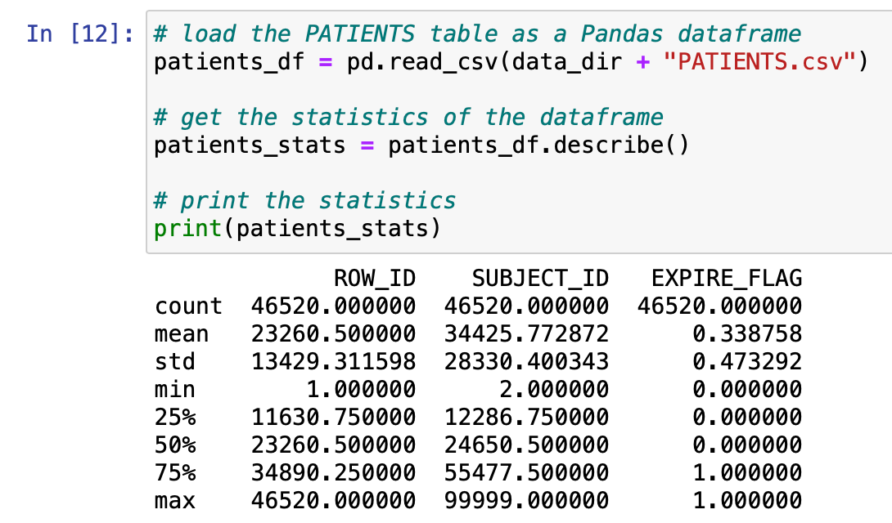
Data Statistics (cont.)

Slide 7
Implementation
Our implementation was original code written by our team members
The first step of our implementation involves reading in the data files, describing the statistics for each data file, and merging them into one pandas dataframe.
This dataframe was then converted into one input hot vector encoding.
We then created the GRU model using the keras library’s Sequential class. It was at this stage that we implemented the ablations with the different activation functions
Finally, we ran the hot vector through the GRU models and outputted the resulting accuracy

Slide 8
Hyperparameters and Computational Requirements
The hyperparameters we set for our implementation (as outlined in the paper) were:
L2 regularization: 0.001
Hidden layer size: 100
Max epoch: 30 (For the initial run we kept the max epoch low to have a successful run)
We were able to run our implementation on a standard personal machine available to general consumers. (Go into more specifics about computational requirements here, like CPU/GPU hours and memory requirements)

Slide 9
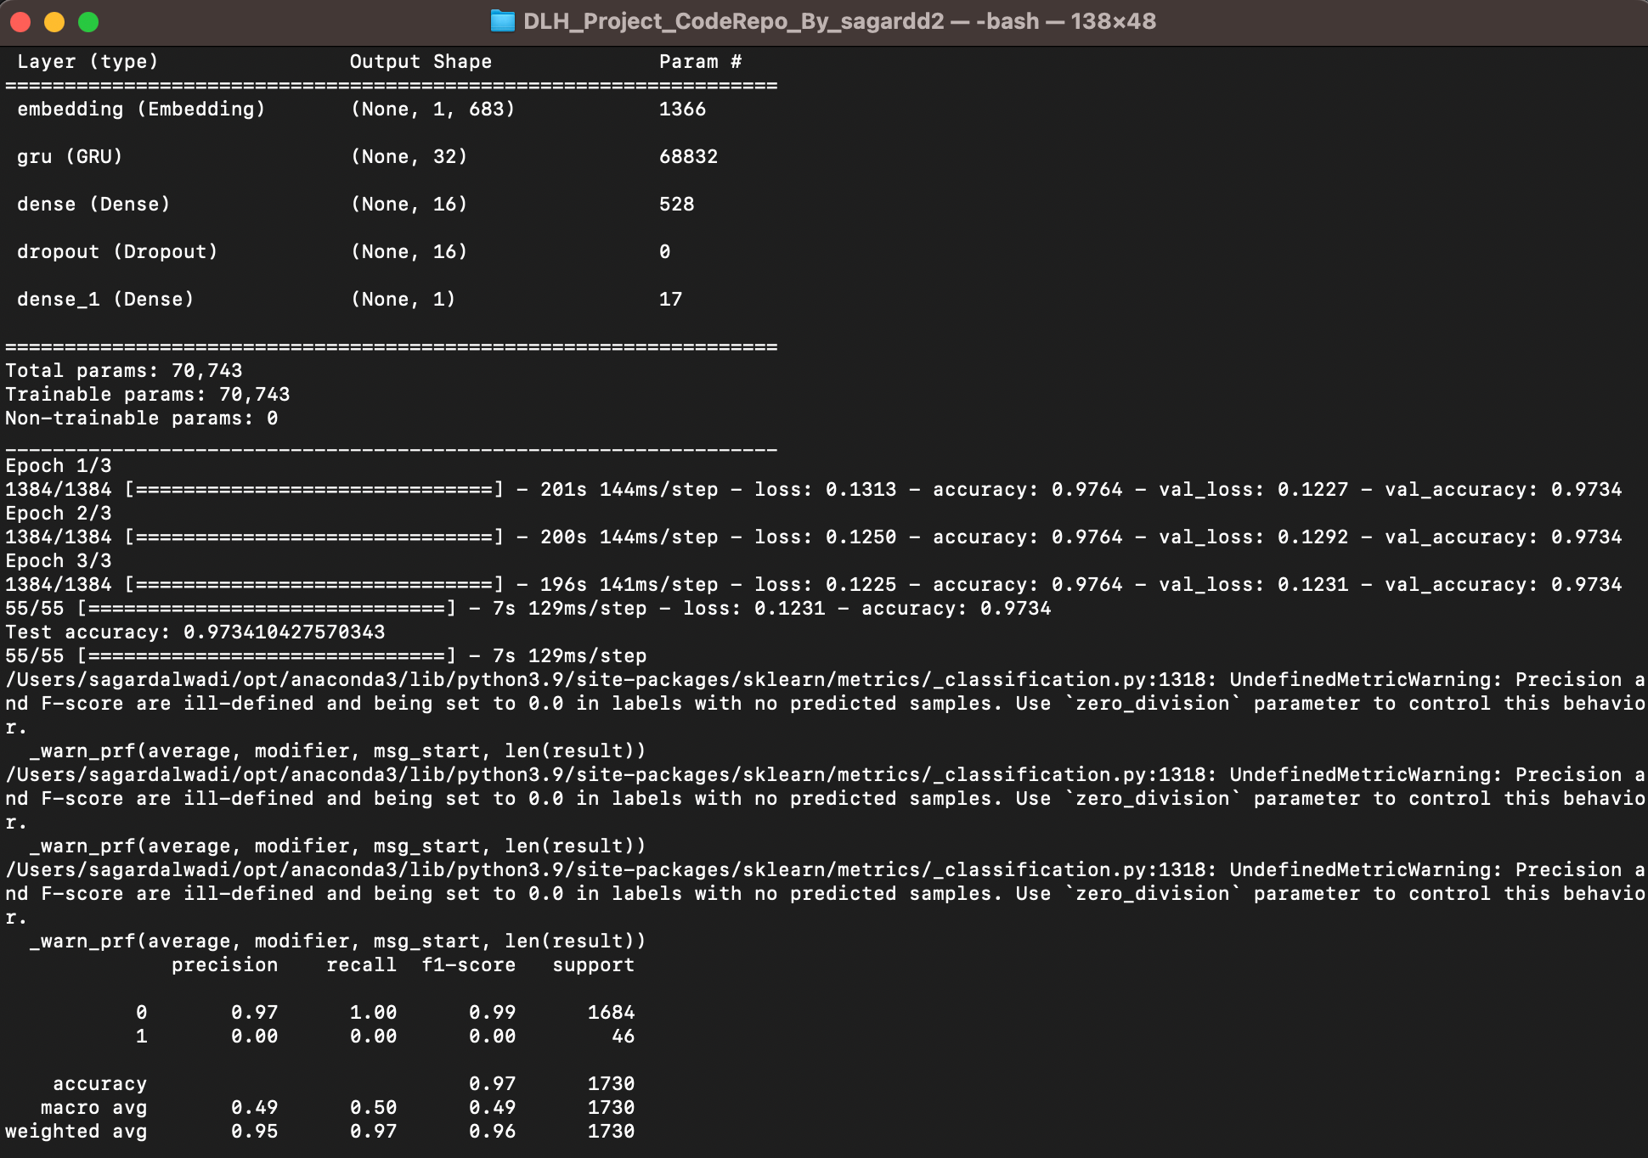
Results
The results from this image are from a GRU with a ReLU activation function. This shows an accuracy of 0.97, with 3 epochs. This shows a high prediction factor for HF in the data

Slide 10
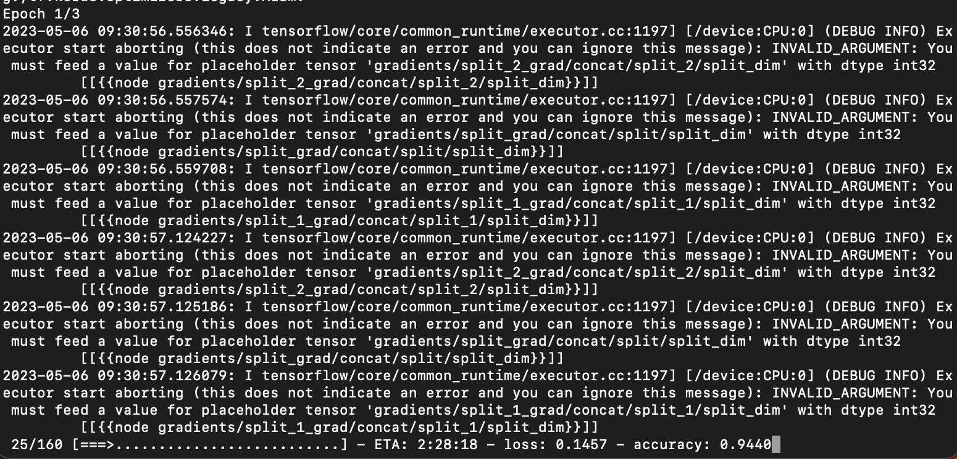
Results (cont.)
The results from this image are from a GRU with a Sigmoid activation function. This shows an accuracy of 0.94, with 3 epochs. This shows a high prediction factor for HF in the data, although slightly lower than with the ReLU activation.

Slide 11
Discussion
The results we obtained from our implementation, with our ablations, are in line with the main claim from the paper.
What was easy (summerize what was easy section from paper here)
What was difficult (summerize what was difficult section from paper here)

Slide 12
Recommendations for reproducibility
Make sure that one has powerful hardware to run the same number of epochs as the original code
If possible, try to collect the data from the original source than through free resources to get the most optimum results
Know that one doesn’t need to use the exact same libraries as described in the original code. If there are libraries that can produce and train a model more efficiently, go ahead and use those.

Slide 13
References
Choi, E., Schuetz, A., Stewart, W. F., & Sun, J. (2017). Using recurrent neural network models for early detection of heart failure onset. Journal of the American Medical Informatics Association : JAMIA, 24(2), 361–370. https://doi.org/10.1093/jamia/ocw112

Slide 14
THANK YOU!

